Slide 1
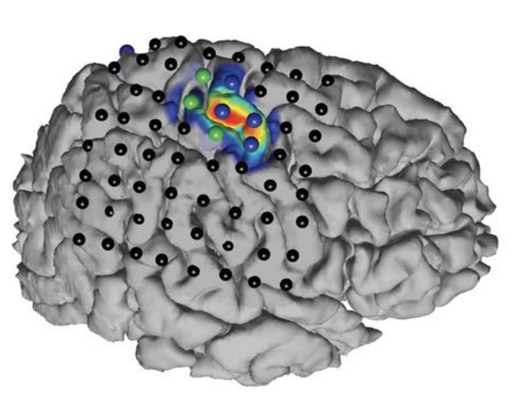
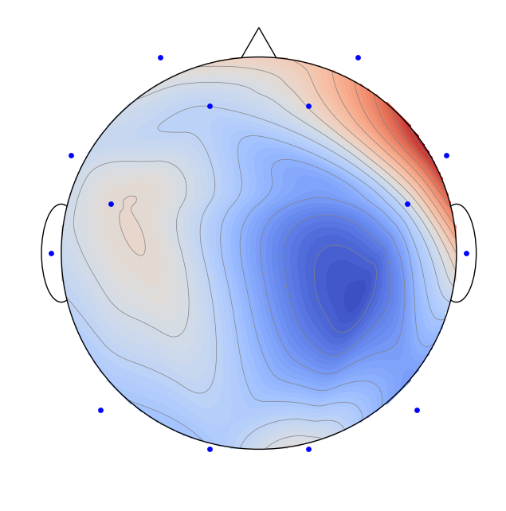
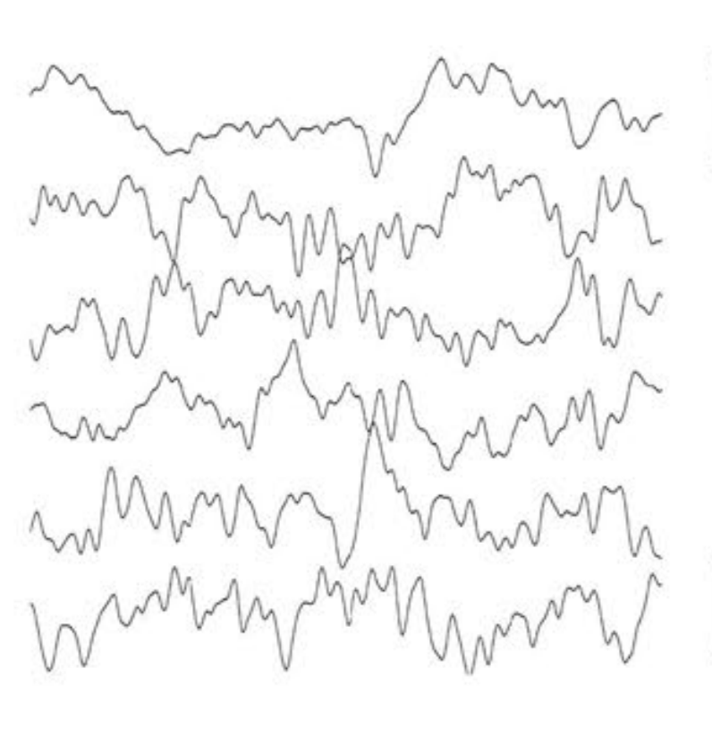
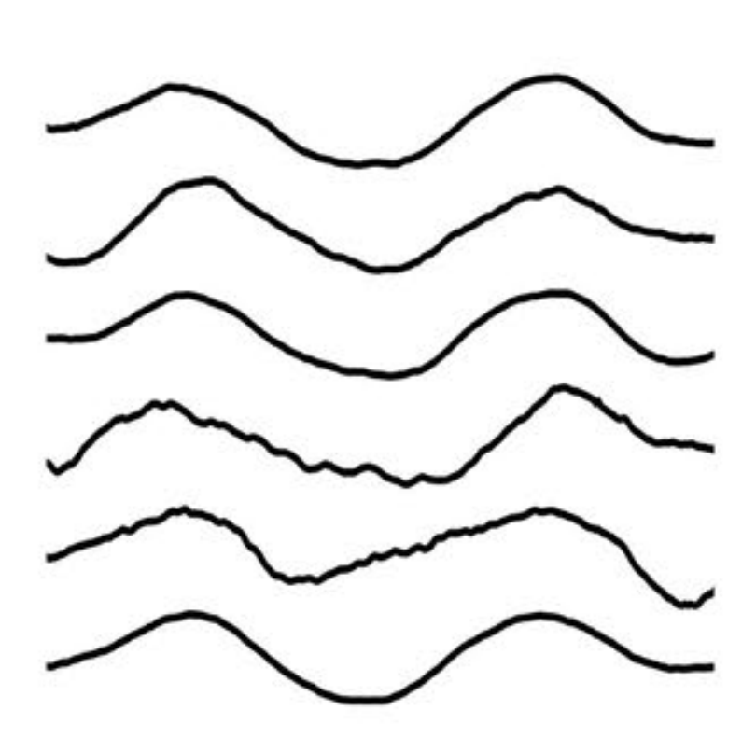
Spatial Filtering for Source Separation in EEG Data
Christian Endl, Felix Wirth, Korbinian Kunst & Taulant Koka

Slide 2
Agena
Graph Blind Source Separation results
Summary of major outcomes
Problems and future research

Slide 3
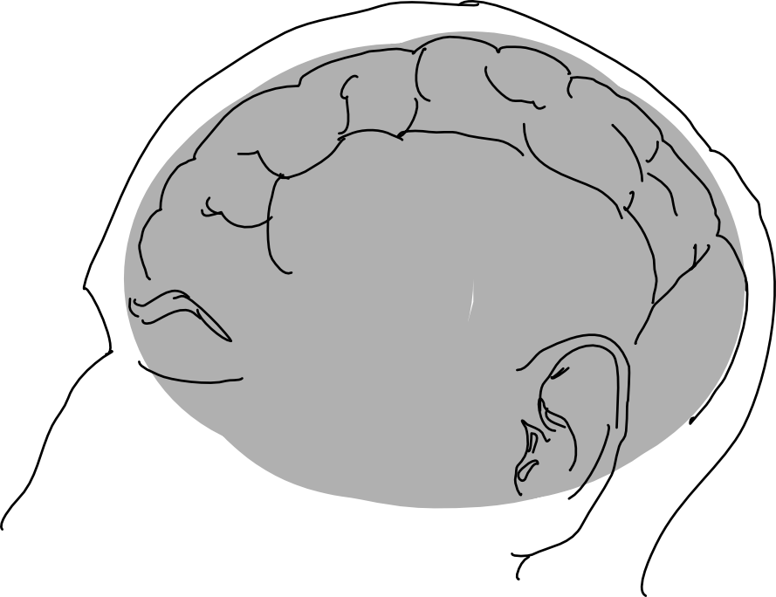
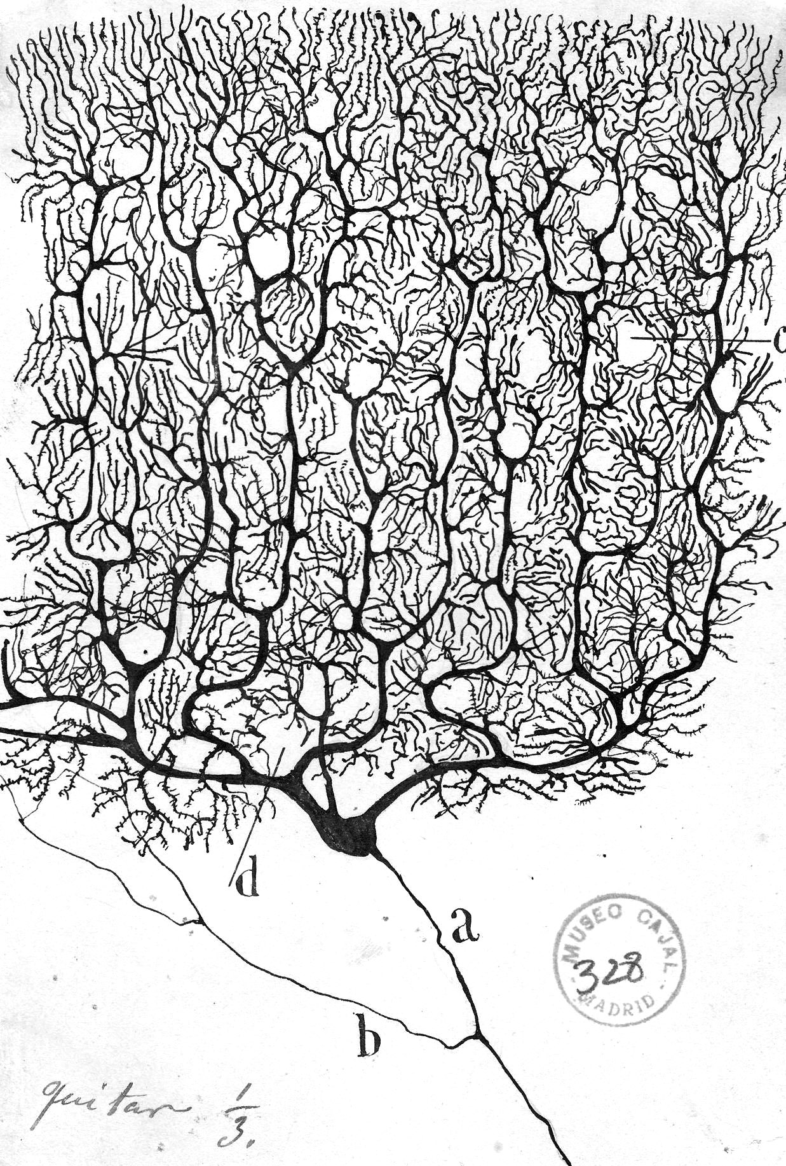
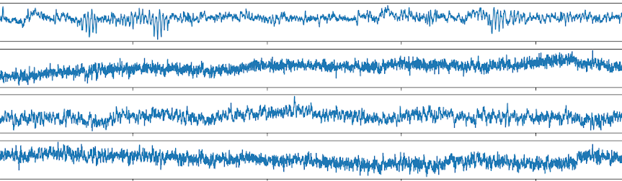
Motivation Challenge of Working with EEG Data
Electroencephalogram (EEG) Concept
What we wish to have?
We are observing the "oscillating slow fields" of neurons in the upper layers of the cerebral cortex.
These changes in electrical potential lead a neuron to be more likely or less likely to fire action potentials and are important in encoding information in the brain.
What do we get in experiments?
“
Working with EEG data is
therefore the process of source separation
EEG Channels
time t in seconds

Slide 4


The Concept of Source Seperation Cocktail Party Problem

